Slide 1

Blockchain Gaming: Revolutionizing the Industry
Blockchain gaming is transforming how we play. It introduces new economic models. Players now have true ownership of their digital assets.

Slide 2
Understanding Blockchain Fundamentals for Gamers
Decentralization
Transparency
Security
No single entity controls the game or assets.
All transactions are recorded on a public ledger.
Blockchain technology is highly secure and tamper-proof.
Grasp the tech. Decentralization ensures fairness. Transparency builds trust. Security protects your investments.

Slide 3
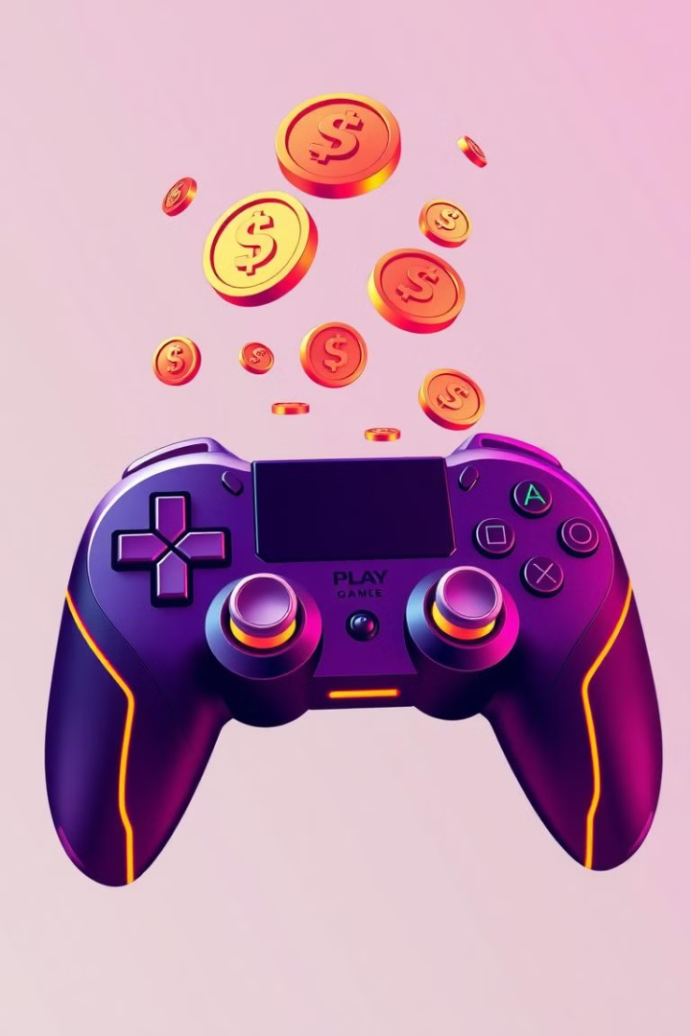
Play-to-Earn: A New Gaming Paradigm
1
Earning Crypto
2
Asset Ownership
Players earn cryptocurrency and NFTs through gameplay.
True ownership of in-game items and characters.
3
New Economy
Creates a player-driven game economy.
Play-to-Earn transforms gaming. It's more than just fun. It's about earning and owning. This creates a whole new economy.

Slide 4
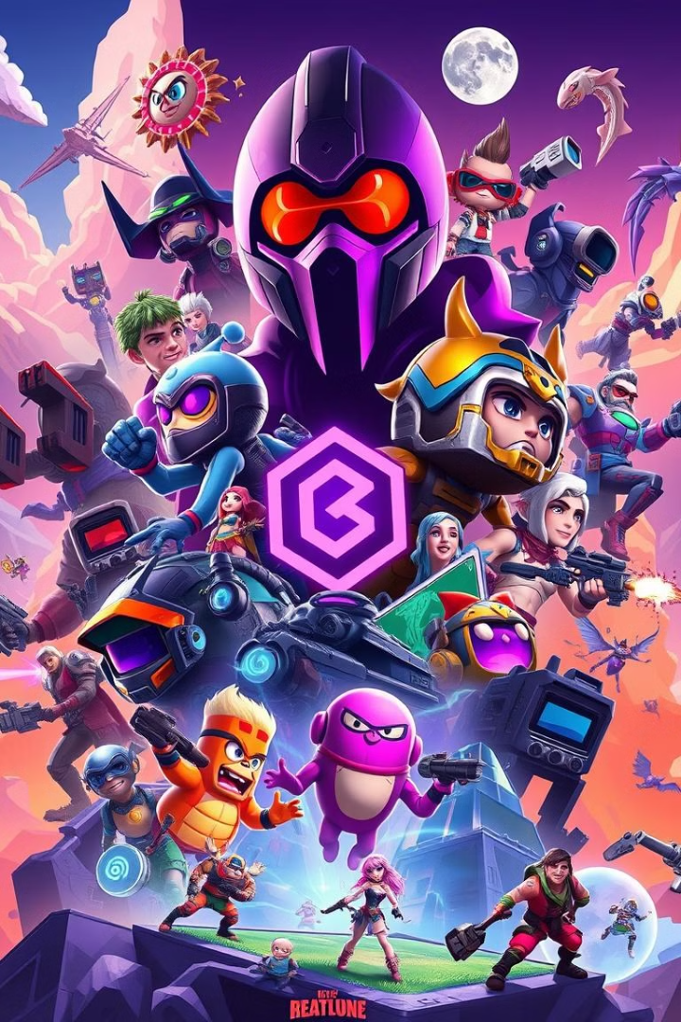



Popular Blockchain Games and Their Mechanics
Axie Infinity
REVV Racing
Sunflower Land
Collect, breed, and battle fantasy creatures.
Own, trade and race NFT cars.
Grow crops and craft items to earn.
Explore leading titles. From battling Axies. To racing NFT cars. Each game offers unique mechanics.

Slide 5




Challenges and Opportunities in Blockchain Gaming
Scalability
1
Regulation
2
4
Innovation
3
Adoption
Blockchain gaming faces hurdles. Scalability, regulation, and adoption are key concerns. But innovation drives new possibilities.

Slide 6
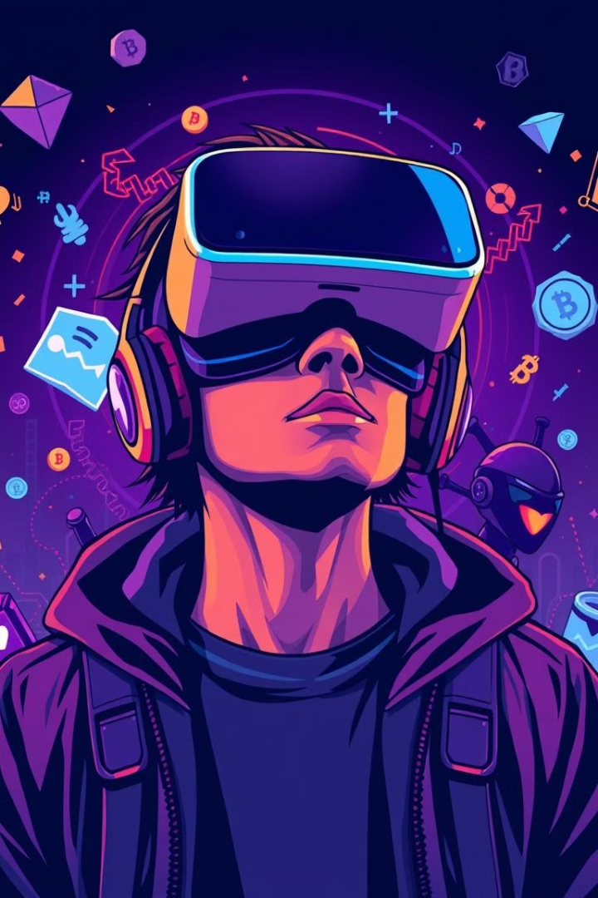



The Future of Gaming: Blockchain Integration
Enhanced Ownership
True digital asset ownership for players.
New Gaming Models
Emergence of play-to-earn and metaverse games.
Community Driven
Empowering players to shape game development.
Blockchain is the future. Expect enhanced ownership. Witness new gaming models. Embrace community driven experiences.

